Slide 1
MRA MILESTONE - 2
Marketing & Retail Analytics
MANISHA PARAKANDLA

Slide 2
Agenda:
Executive Summary of Data
Exploratory Analysis and Inferences
Use of Market Basket Analysis (Association Rules)
Associations Identified
Suggestion of Possible Combos with Lucrative Offers

Slide 3
Problem Statement
A Grocery Store shared the transactional data with you. Your job is to identify the most popular combos that can be suggested to the Grocery Store chain after a thorough analysis of the most commonly occurring sets of menu items in the customer orders. The Store doesn’t have any combo meals. Can you suggest the best combo meals?
Exploratory Analysis
Exploratory Analysis of data & an executive summary supported by graphs.
Trends across months/years/quarters/days etc.
Data: dataset_group.csv
The dataset consists of 20,641 rows and 3 columns (Order_id, Date, Product)

Slide 4
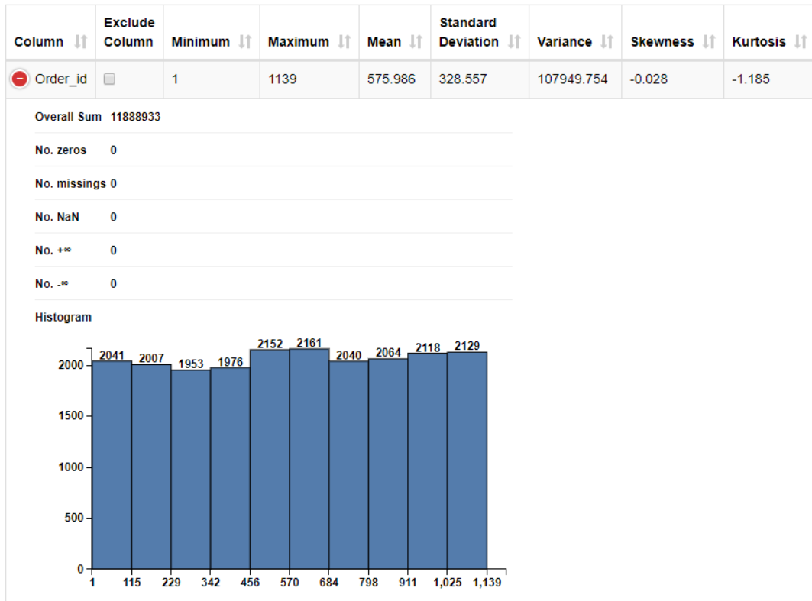
Exploratory Data Analysis:

Slide 5
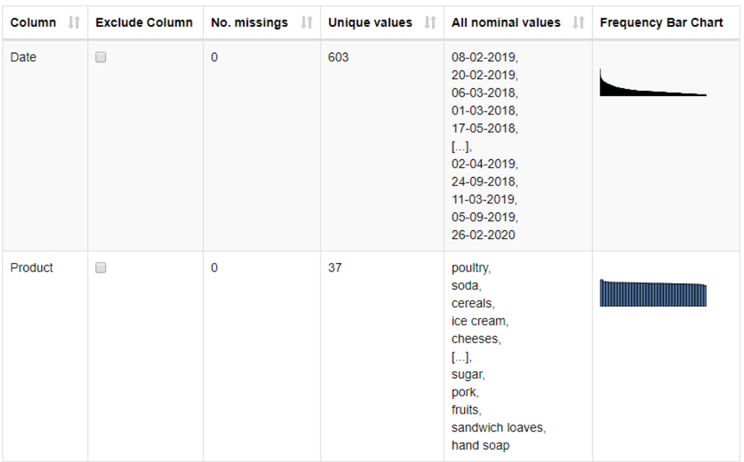

Slide 6
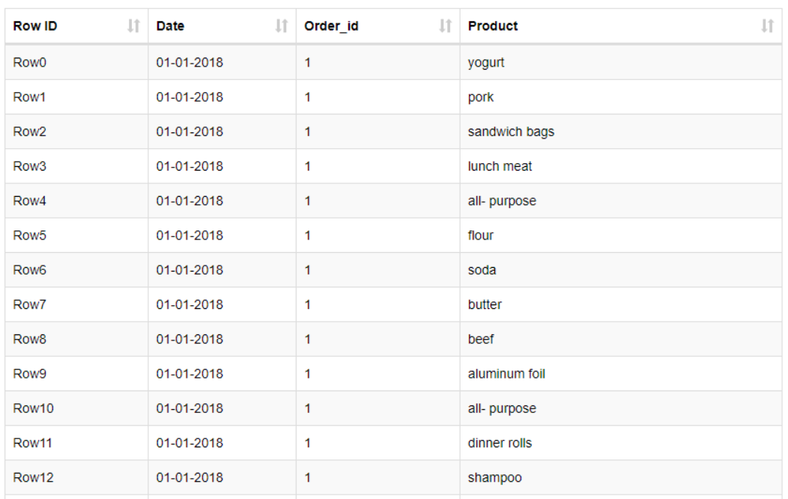
Sample of the data:
Exploratory data Analysis performed in Tableau as well. The workflow is published in the Tableau Public.
Tableau Public URL:
https://public.tableau.com/app/profile/manisha.parakandla/viz/MRA_Milestone2_EDA_mp1/ProductAnalysis

Slide 7
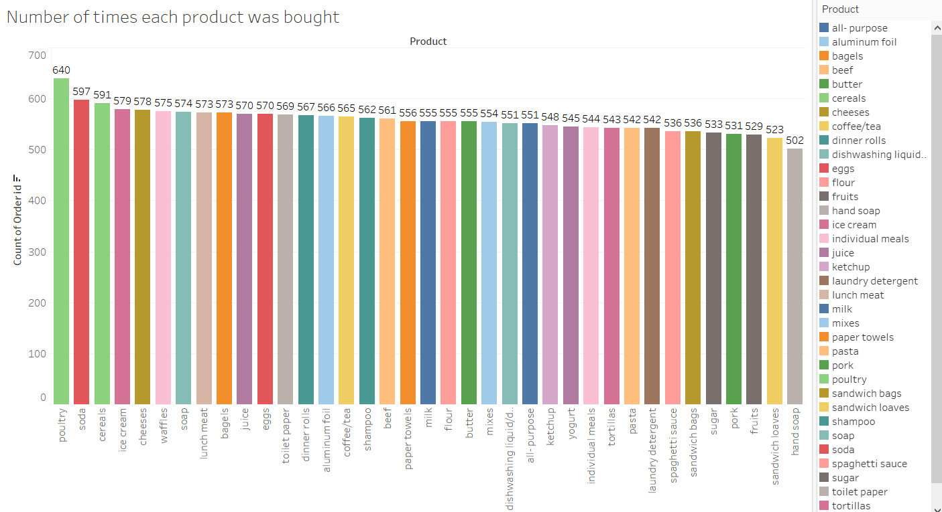
Poultry shows the highest number of times bought.

Slide 8
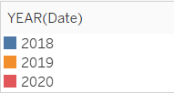
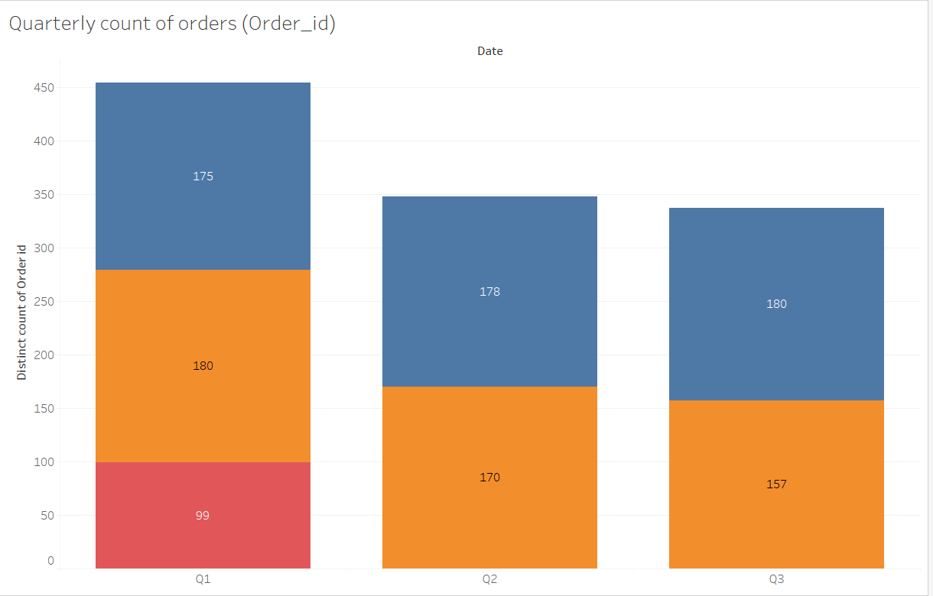
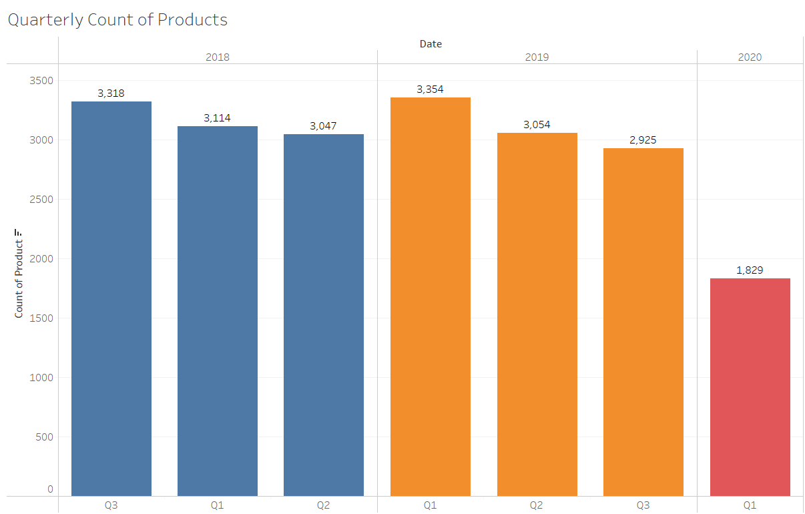
Quarterly Count of orders and products:
The orders placed were less for the year 2020 in first quarter. We can also see the products sold is also less in Q1 2020.

Slide 9
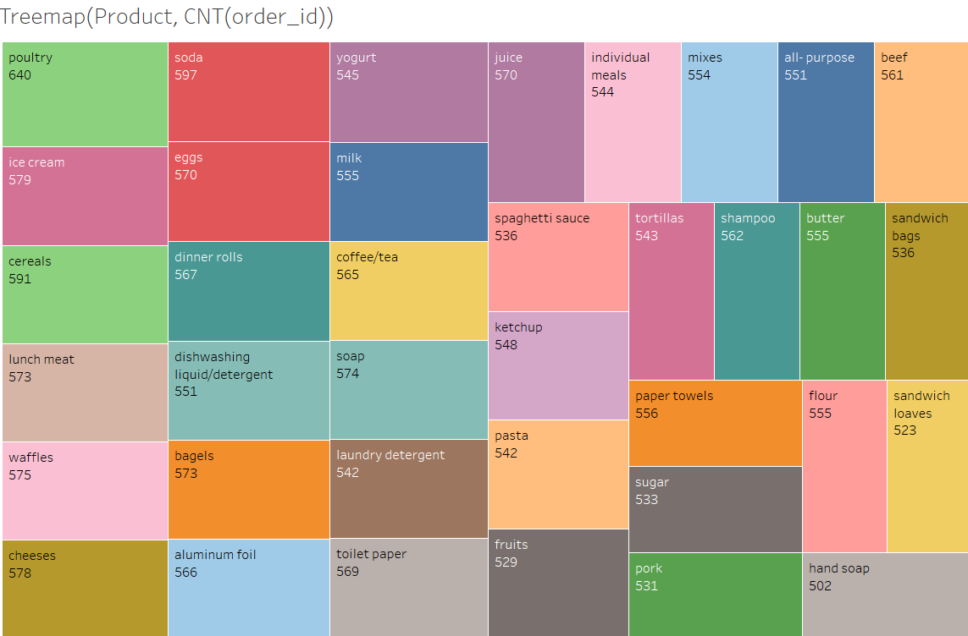
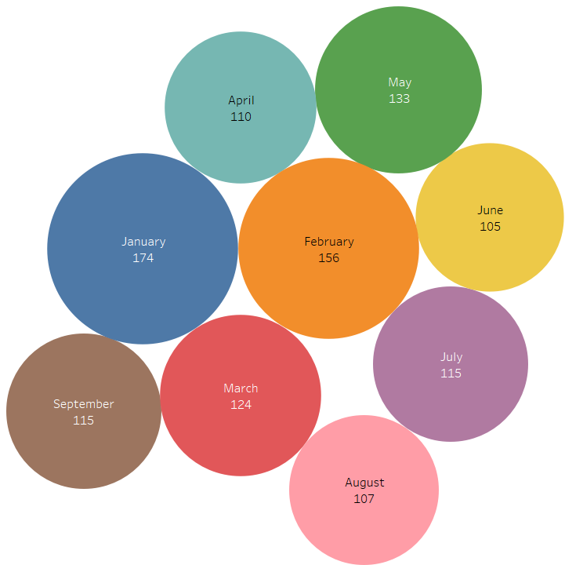
Tree map to show the total number of orders placed each product. Orders Placed Monthly:

Slide 10
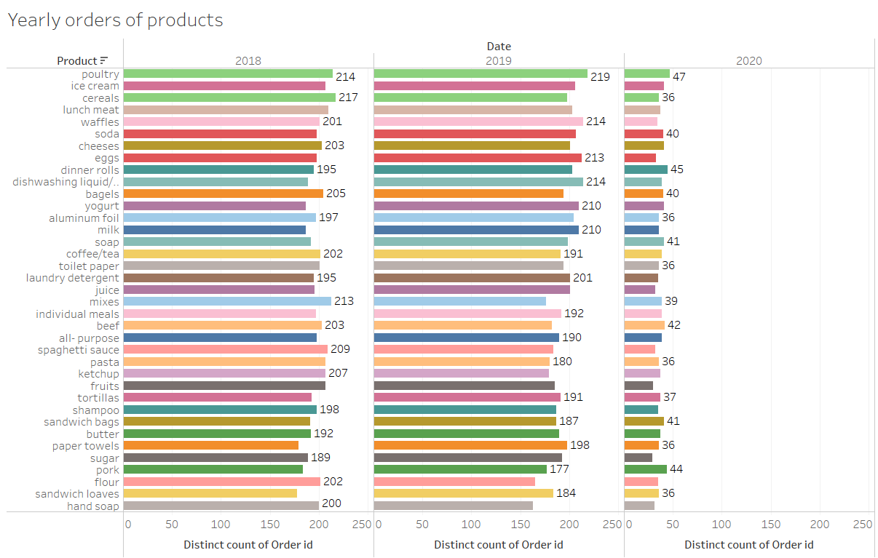
Orders placed in 2020 are very less compared to 2018 and 2019.

Slide 11
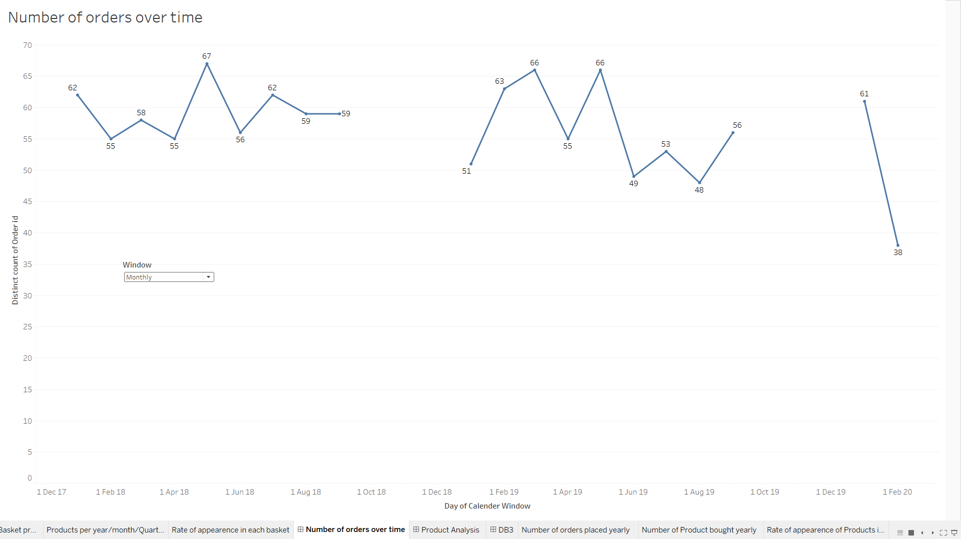
The interactive dashboard shows the Yearly/Quarterly/Monthly/Weekly sales trend for all products.

Slide 12
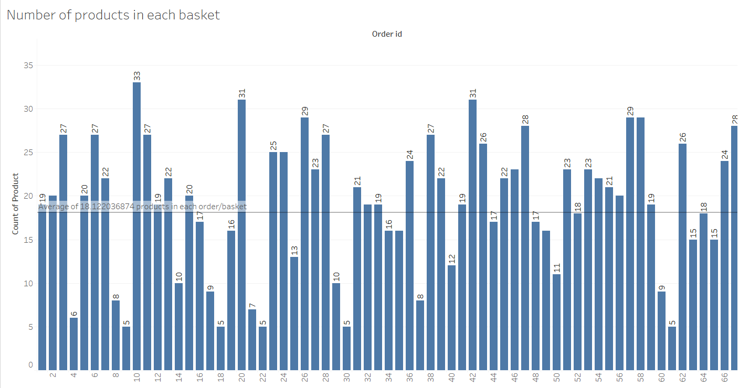

Slide 13
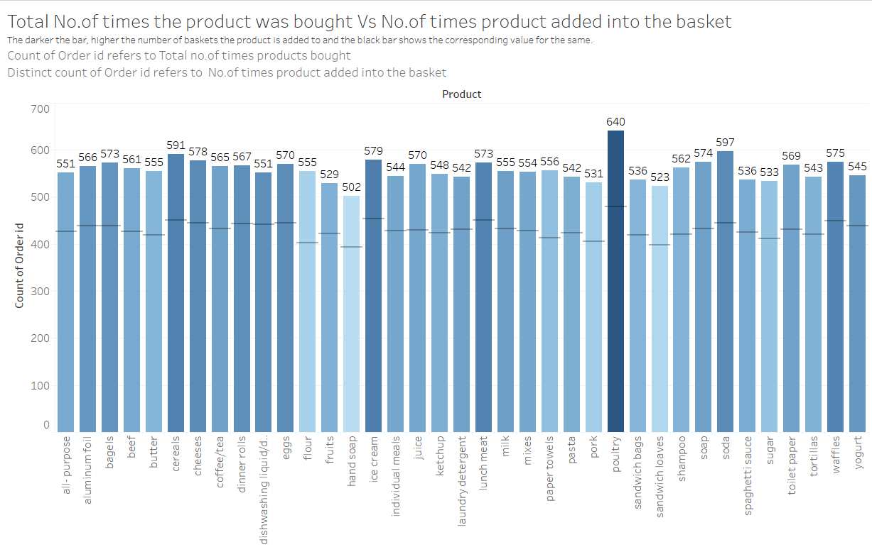

Slide 14
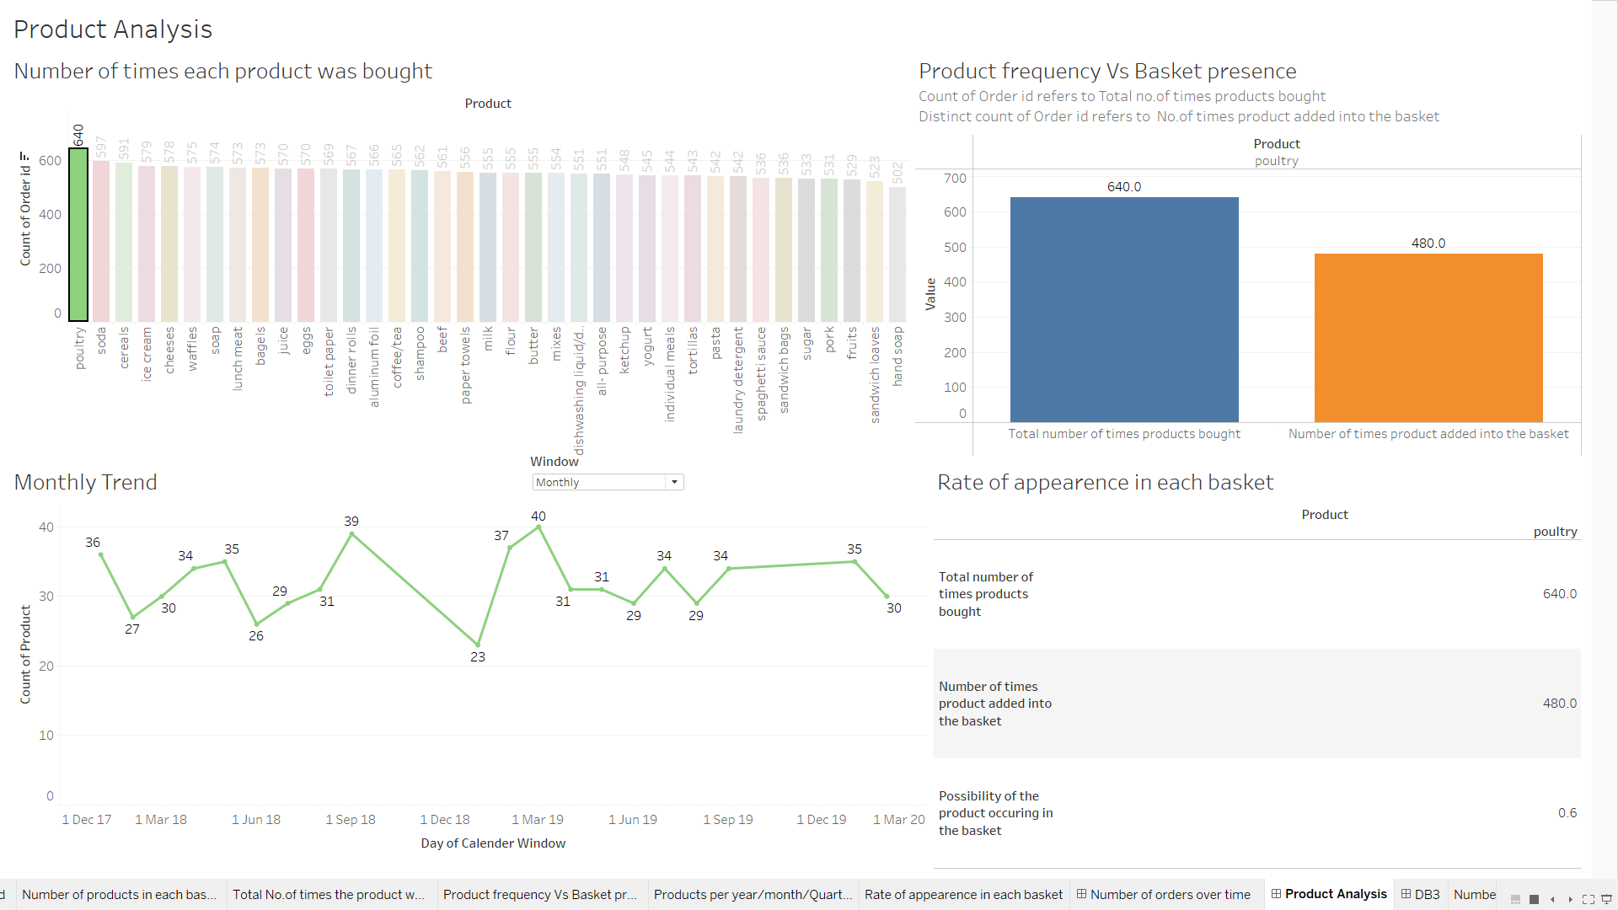
Product Analysis dashboard: This interactive dashboard shows the product analysis of each individual product with its sales trend and probability of the product occurring in basket.

Slide 15
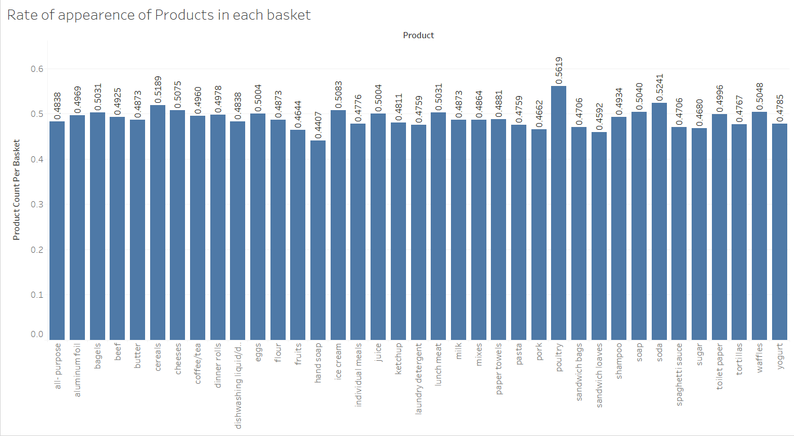

Slide 16
Inference:
→ In the years 2018 and 2019 there is a huge demand in sales for all the products.
→The reason behind is almost all the products having highest sales are eatable items which we consume everyday. Specially poultry, cereals, soda, ice cream are having the high frequency of consumption.
→The demand for poultry and soda topped the list followed by cereals and Ice cream where as demand for sandwich loaves and hand soap are very less compared to all the products.
→ We can also observe that, In the year 2020, the sales of the products and demand falls drastically for all products. It might caused due to the coronavirus pandemic.
→ Due to this the sales took a sharp dent with downfall trend.

Slide 17

Market Basket Analysis(MBA) :
Market basket analysis is a technique used by retailers to increase sales by better understanding customer purchasing patterns. It involves analyzing large data sets, such as purchase history, to reveal product groupings, as well as products that are likely to be purchased together.
It works by looking for combinations of items that occur together frequently in transactions. To put it another way, it allows retailers to identify relationships between the items that people buy.
Market Basket Analysis, Example:
MBA aims to find relationships and establish patterns across purchases. The relationship is modeled in the form of a conditional algorithm:
IF {sandwich, cookies} THEN {drink}
In the shorthand notation, which translates to “the items on the right are likely to be ordered with the items on the left:”

Slide 18
Association Rules:
A collection of items purchased by a customer is an itemset. The set of items on the left-hand side (sandwich, cookies in the example above) is the antecedent of the rule, while the one to the right (drink) is the consequent.
The probability that the antecedent event will occur, i.e., a customer will buy a sandwich and cookies, is the support of the rule. That simply refers to the relative frequency that an itemset appears in transactions. In a QSR, the support of an item or item combination helps to identify keystone products. Hence, if a sandwich and cookies have high support, then they can be priced to attract people to the store.
The probability that a customer will purchase a drink on the condition of purchasing a sandwich and cookies is referred to as the confidence of the rule. Confidence can be used for product placement strategy and increasing profitability. Placing high margin items near associated high confidence (driver) items can increase the overall margin on purchases.
The lift of the rule is the ratio of the support of the left-hand side of the rule (sandwich, cookies) co-occurring with the right-hand side (drink), divided by the probability that the left-hand side and right-hand side co-occur if the two are independent.
Let us now perform the Market Basket Analysis using KNIME

Slide 19
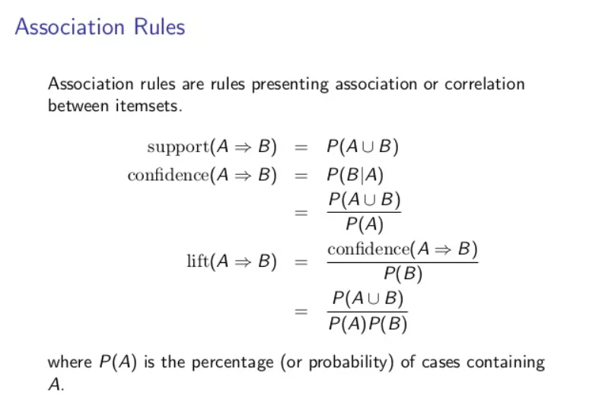

Slide 20
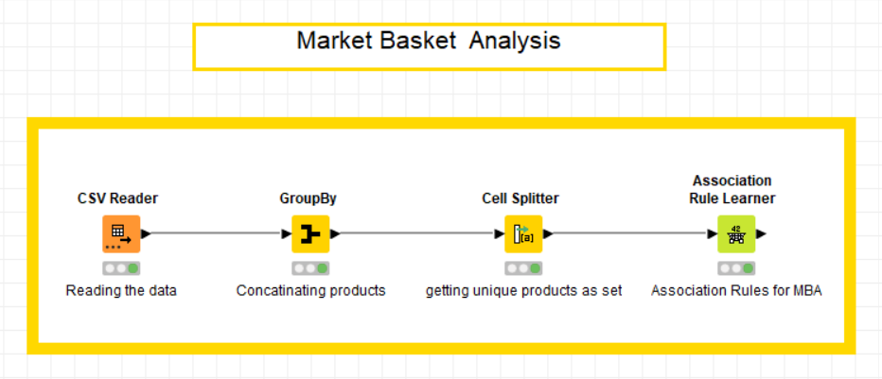
KNIME Workflow:
Association rule is the set of rules where the likelihood of buying a product is greater with a set of product.
For example, paper towels being bought along with set of [eggs, dinner rolls, ice cream, pasta, lunch meat] is 2.349 times higher when compared to it being bought individually which is just 0.02.

Slide 21
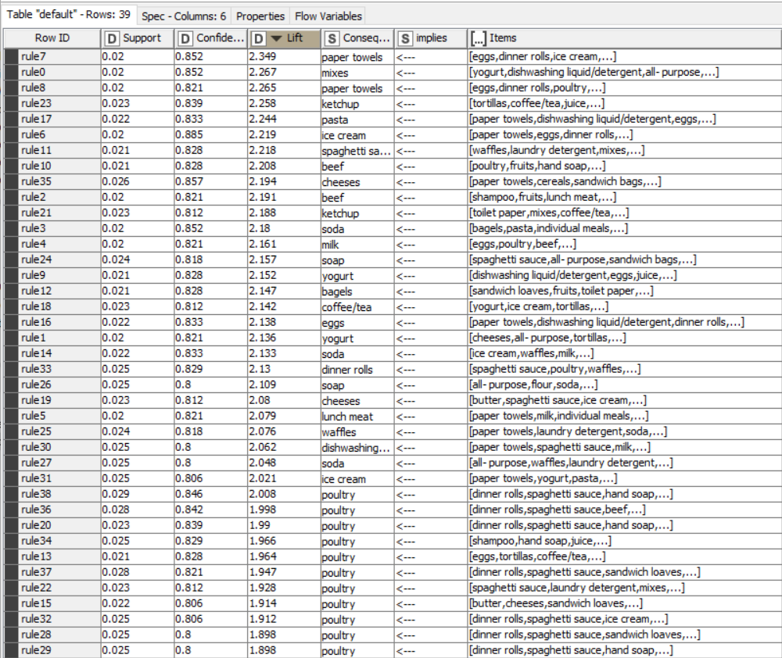

Slide 22
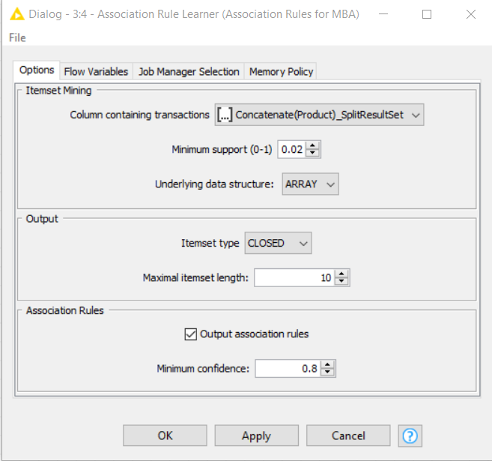
Threshold values are found through various regressions as shown below:
1.Support of Minimum = 0.02
2.Maximum item set length = 10
3.Minimum Confidence level = 0.08

Slide 23
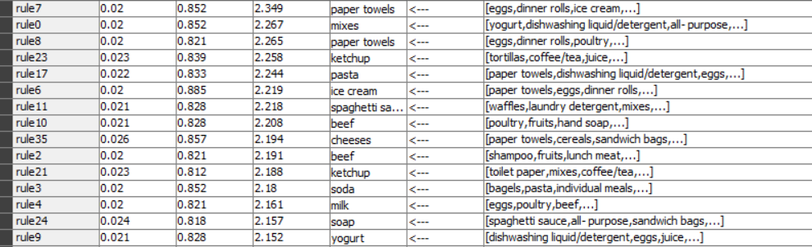
Inferences & Recommendations:
→Poultry can be suggested as a combo offer with most of the food and snacks such as dinner rolls and spaghetti sause.
→Soda can be another item which can be offered included with combo offer.
→The top combos with good confidence and high lift values are:
We can place the products with easy lift-up counter of the top combinations near the sales counter or the billing counter to increase the sales of preferred combinations. We can also group all these products at one place so that customers who often buy the same combination of products buy them as well. This way we can attract the customers more to buy more products.
→Since, poultry and soda are the most sold items with high demand where as sandwich loaves and hand soap are items with less demand, a combo offer of these would eventually increase the sale of the less demand products.

Slide 24
→Launching new discount offers and combo offers on the low demand products can help increase the sale.
→Discount coupons on low demand products and complementary gifts to the customers help them to try those products and can have chances of buying them again next time. This can increase the sales and also attracts the customers to try and buy more products.
Combo Offers:
1. Poultry with eggs(buy poultry and get a carton of eggs for free, assuming carton containing dozen eggs)
2. Cheese with sandwich bags and Bagels.
3. Poultry, Beef, Spaghetti sauce with dinner rolls & eggs.
4. Combo of lunch meat, waffles with juice.
Discounts:
1. 10% off if you buy Poultry with one egg carton.
2. 5% off on Cheese with Bagels.
3. 15% off on Poultry, Beef if bought together.
4. 5% off on Milk and Ice cream if bought together.

